Slide 1

C{}DE-A-TH{}N - 2022
Assignment 3

Slide 2
Q. 1 A. Write a C/C++ or Python program to perform 3D convolution
B. Deploy the above code on GPU using CUDA C++/ CUDA Python
Consider the matrix size sufficiently large eg. 512 x 512 x 512 of type double. (If memory limitation reduce size to 256 x 256 x 256 likewise)
Consider mask size as 9 x 9 x 9 and appropriate pad size
Measure the performance of sequential version and optimized parallel version
Calculate the speedup observed
You may execute sequential programs on your local machine
However all parallel codes must be executed on server
Parallel versions considered for evaluations only if both sequential and parallel codes gives same output

Slide 3
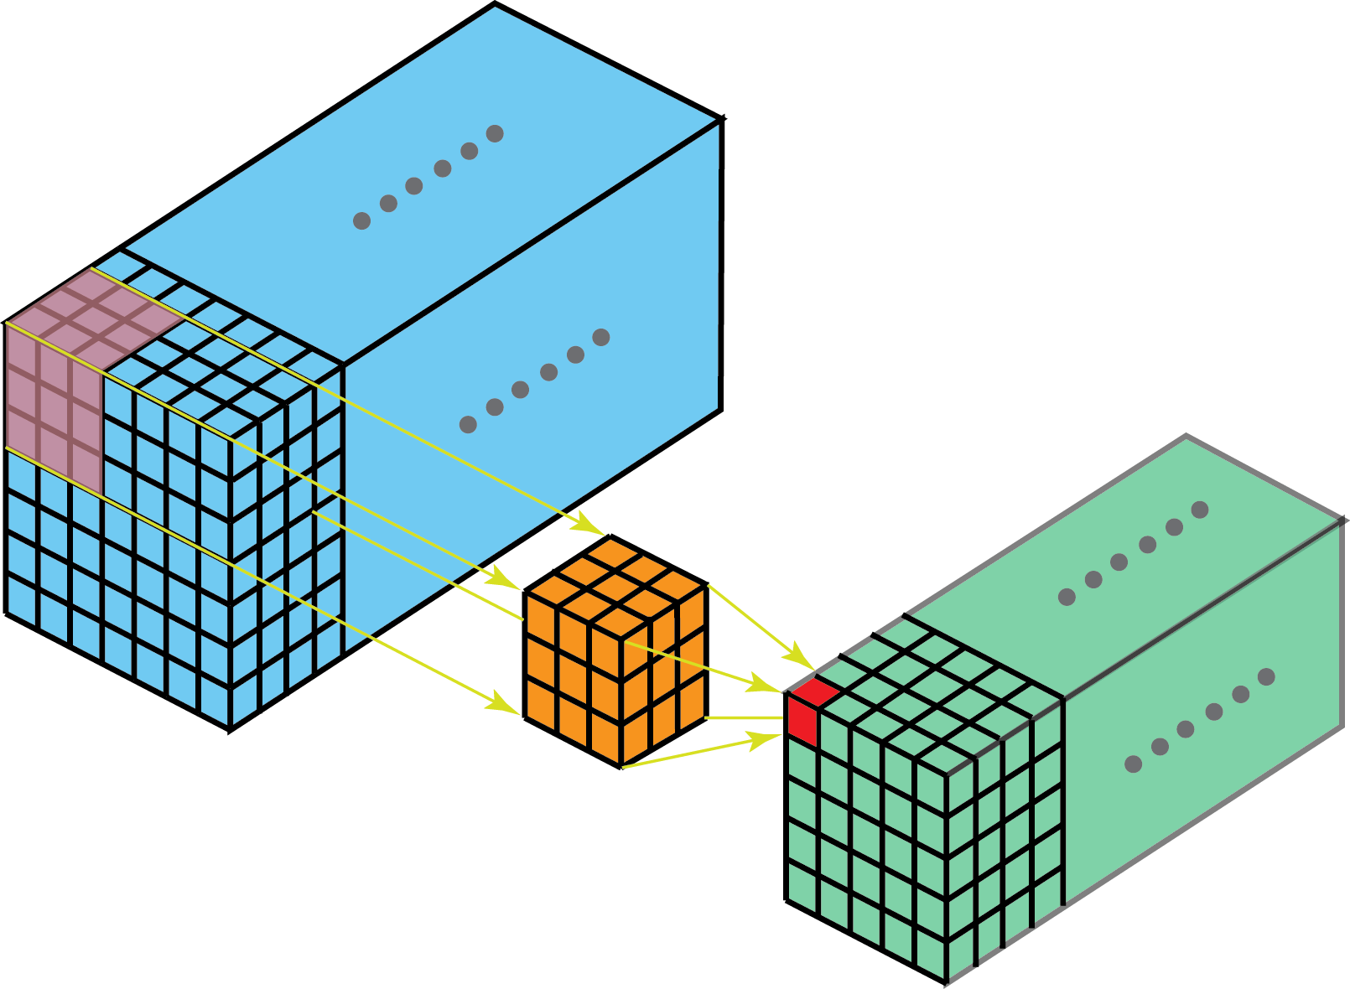
What is 2D and 3D Convolution?
2D
3D

Slide 4
Submission
Explain in brief your parallelization strategy like data splitting, thread/block creation, and allocation etc.
Ans: Ans: We first calculate the optimal number of threadsperblock and numberofblocks using the inbuilt functions cudaDeviceGetAttribute and some observations then we use cudaMallocManaged() to initiliase the memory for the array and the answer variable so that we could use it both on the host(CPU) and the device(GPU). Then after initialising the values on the CPU we use cudaMemPrefetchAsync() to asynchronously prefetch memory to the device to reduce the number of page faults and on demand memory migration overhead which would have significantly slowed down our program.
In this question we were to perform 3D convolution. For simplicity we implemented the 3D array using a 1D array with proper indexing wherever needed. Then we call the kernel in which we use a normal grid stride loop which calculates the value of each index of the output 3d array using the mask provided to the kernel. After the kernel has finished its work we synchronize it using cudaDeviceSynchronize().
In the end we free the memory which we had allocated earlier.

Slide 5
Submission
Insert your findings into the below table
Ans: (For dimension (100*100*100), since sequential code couldn’t be executed for more than that)
 | Sequential Time | Parallel version 1 time | Parallel version 2 time | Speedup wrt parallel version 1 | Speedup wrt parallel version 1
3D Conv | 4834109000 nanoseconds | 16314576 nanoseconds |  | 296.306 Times faster
Note:- In case if needed you can add more columns if you have implemented multiple parallel
versions

Slide 6
Submission
Comment on your observations such as limitations of proposed solution, etc.
Ans: Even though the code is much faster than the sequential version still it is slow due to the nature of the convolution operation.

Slide 7
Submission
Rename the file as <TEAM_NAME>_Assignment3
Send the presentation file with source code

